Slide 1

Mental Health Meme Classification
Aman Chauhan (MT23015)
Megha (MT23125)
Submitted to: Md. Shad Akhtar

Slide 2
PROBLEM STATEMENT
Memes have become a modern way for people to express their mental health struggles, especially through figurative language (like irony, sarcasm, or symbolism). For example, someone might use a funny image to subtly hint at their anxiety or depression.
However, current Multimodal Language Models (MLMs) — AI models that understand both images and text — struggle to interpret the hidden emotional meaning in such memes. Humans use commonsense and background knowledge to get the joke or emotion behind a meme, but most AI models don’t have that ability.

Slide 3
MOTIVATION
Memes are becoming a popular medium for expressing complex emotions, especially among youth.
People often use memes to hide or indirectly express anxiety, stress, or depressive thoughts.
Most VLMs are trained for literal text-image alignment (e.g., object detection, captioning).
Models tend to miss the underlying mental state, especially in humor-rich content like memes.
We need models that can reason like humans, by blending commonsense knowledge with multimodal inputs.

Slide 4
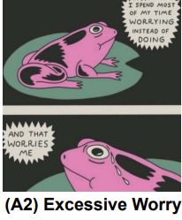
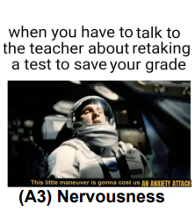
DATASET
AxiOM Dataset:
Anxiety Meme Ontology built using GAD (Generalized Anxiety Disorder) questionnaire as the base. - Includes 3582 memes and memes are annotated for six fine-grained anxiety symptoms (e.g., restlessness, excessive worry).

Slide 5
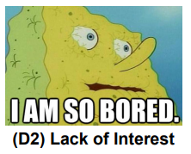
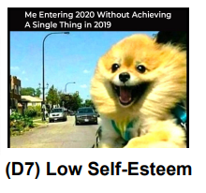
DATASET
RESTORE Dataset: This is publically available data for meme depressive symptom classification.
In this memes are annotated for 8-fine grained depressive symptoms (e.g., Feeling Down, Sleeping Disorder).

Slide 6
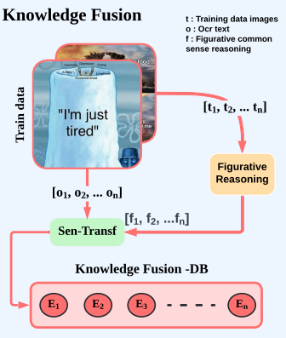
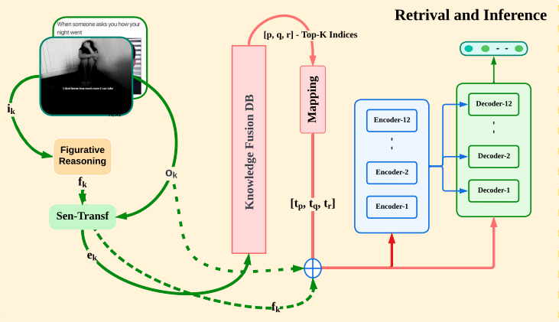
RELATED WORK

Slide 7
METHODOLOGY
Visual+OCR Extraction :
We begin by extracting the textual content from memes using EasyOCR. Simultaneously, we employ BLIP to generate visual captions for each meme image, capturing a high-level semantic summary of the visual content.
Figurative Reasoning Generation:
To model deeper psychological context, we generate figurative reasoning triples—specifically: Cause-Effect, Figurative Understanding, and Mental State. This is done using LLaMA-3.3-70B-Instruct, served via NVIDIA NIM APIs.
The prompts are constructed by combining each image’s OCR text and visual description, ensuring the generated reasoning reflects both textual and visual cues embedded in the meme.

Slide 8
METHODOLOGY
3. Knowledge Fusion:
We construct a Knowledge Fusion Database using the processed training meme data. For each image, we fuse three modalities: OCR text (o), visual description (v), and figurative reasoning (r).
Each tuple ⟨o, v, r⟩ is embedded into a unified space using a Sentence Transformer, producing dense representations. These embeddings form the basis of our retrieval-augmented generation (RAG) pipeline, which guides the final classifier.

Slide 9
METHODOLOGY
4. Retrieval with cosine similarity:
For each input meme, we compute its embedding by concatenating the Sentence Transformer-based encodings of:
OCR text (oₖ)
Visual description (vₖ)
Figurative reasoning (rₖ)
This query embedding is then compared against our Knowledge Fusion DB using cosine similarity.
We retrieve the top-k most similar memes (excluding the query itself) based on similarity scores.
These retrieved samples represent contextually and semantically aligned memes, enriching the final classification prompt with relevant references.

Slide 10
METHODOLOGY
5. Classification (Retrieval-Augmented Few-Shot setting)
We use a BERT-based encoder-only classification model (bert-base-uncased) from Hugging Face’s Transformers library, fine-tuned for multi-class anxiety symptom prediction.
This RAG-style input prompt simulates a few-shot learning setting, where retrieved memes act as semantic exemplars, providing reasoning scaffolds to improve classification accuracy.
The model outputs a softmax probability distribution over the target anxiety categories, and we use cross-entropy loss during training.
Evaluation is done using macro F1 and weighted F1 metrics to account for both balanced and imbalanced class distributions.

Slide 11
OUR NOVELTY
Open-Source Figurative Reasoning Generation (No API Cost): In the original paper, GPT-4 is used to generate figurative reasoning by conditioning on both the OCR text and the meme image—a method that requires subscription-based access to proprietary APIs.
Instead, we leverage open-access alternatives EasyOCR, BLIP, LLaMA-3.3-70B-Instruct, this makes our pipeline cost-effective, scalable.
Expanded Knowledge Fusion: (o, v, r) Triplets.
Interpretable and Modular Design: Each component—OCR, captioning, reasoning, retrieval, and classification—is modular and transparent. - Enables easier debugging, reasoning validation, and future adaptation to new meme types or mental health domains.

Slide 12
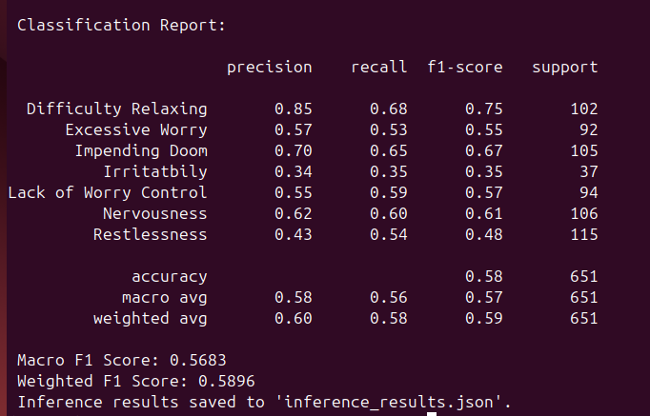
RESULTS
FUSE-MH:(Figurative-understanding And Semantic Embedding for Mental health memes)

Slide 13
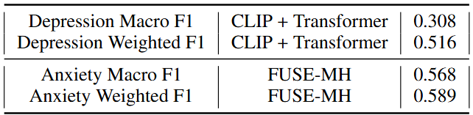
RESULTS
CLIP + transformer:
Performing good on the Depressive but bad on Anxiety data.

Slide 14
CONCLUSION
Improved Performance on Anxiety Classification: Outperformed prior CLIP+transformer setups significantly (Macro F1: 0.57 vs 0.13 on anxiety).
Helps bridge gaps in VLMs that miss irony, sarcasm, and symbolism—especially critical in mental health memes.
Incorporating figurative reasoning triples (cause-effect, metaphor, emotional state) ensures the model goes beyond surface-level text and interprets deeper psychological cues.
Top-K example retrieval from a knowledge fusion database helps guide the model using similar past examples, enabling few-shot learning and improved generalization.

Slide 15
FUTURE WORK
We can explore the direct visual embeddings (e.g., from ViT or CLIP) integrated with textual reasoning to capture non-verbal cues like facial expressions.
Can extend FUSE-MH to support memes across cultures and languages, incorporating cultural commonsense reasoning for better global applicability.
Incorporating Larger Language Models: While Meta LLaMA 70B provided strong figurative reasoning through prompt-based generation, future iterations could explore more advanced models like LLaMA 3-430B, offering improved contextual understanding and symbolic reasoning.

